Slide 1

OKCupid’s collected data
can be used to identify characteristics contrary to being a positive individual
Machine Learning Fundamentals
Terry Boxx
January 1, 2019
Codecademy

Slide 2
In recent years, there has been a massive rise in the usage of dating apps to find love. Many of these apps use sophisticated data science techniques to recommend possible matches to users and to optimize the user experience. These apps give us access to a wealth of information that we've never had before about how different people experience romance.
In this analysis we answer the questions,
“Can the same data can be used to identify people that are generally more or less positive?”
“Which machine learning method offers most promise in pursuing future detailed work?”

Slide 3
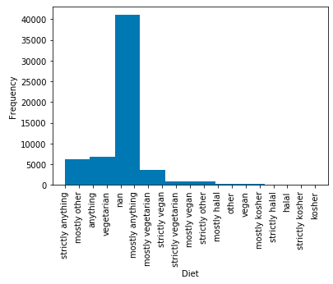
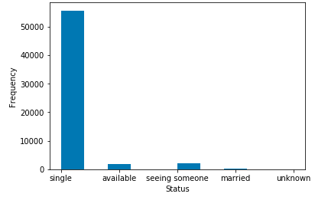
Index(['age', 'body_type', 'diet', 'drinks', 'drugs', 'education', 'essay0', 'essay1', 'essay2', 'essay3', 'essay4', 'essay5', 'essay6', 'essay7', 'essay8', 'essay9', 'ethnicity', 'height', 'income', 'job', 'last_online', 'location', 'offspring', 'orientation', 'pets', 'religion', 'sex', 'sign', 'smokes', 'speaks', 'status'], dtype='object')
Insufficient data
The OKCupid data was reviewed towards picking likely indicators for positivity outlook
Some items are insufficient for this analysis

Slide 4
Reviewing the data pointed to features of diet, drinks, drugs, and smokes as possibly contrary to being positive.
The features were mapped, and columns added, to provide a scale with more extremes as a higher number.
The essay answers can provide insight into a positive mindset through the frequent use of words such as ‘love’, ‘friend’, ‘joy’, ‘enjoy’…
drink_mapping = {
"not at all": 0,
"rarely": 1,
"socially": 2,
"often": 3,
"very often": 4,
"desperately": 5}

Slide 5
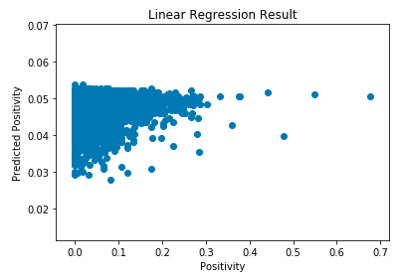
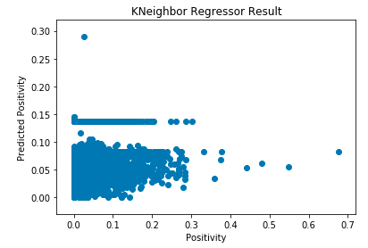
Regression techniques offered little value in identifying a predictor
Linear Regression Results
Train Score: 0.005137
Test Score: 0.0054867
KNeighbor scored best
KNeighbor Regressor Results
Train Score: -0.336249
Test Score: -0.3361986

Slide 6
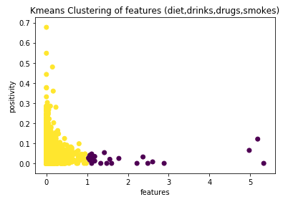
Combining the normalized features into a composite product score shows the best promise to pursue after using Kmeans clustering!
features = ['diet_code'] * ['drinks_code'] * ['drugs_code'] * ['smokes_code'] / (0.5)**3
A composite features score greater than 1 can identify a less positive individual

Slide 7
Future Steps
A more thorough natural language technique would be beneficial in pursuing for analyzing the essay questions. (i.e. NLTK)
The use of Kmeans classification and Kneighbor Regression offer the most promise for advancing the discovery towards a useful screening filter.

